Slide 1
MAVZU: Matematika darslarini noan’anaviy tarzda tashkil etish
Muxammadiyeva Dilorom

Slide 2
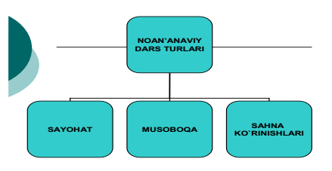

Slide 3
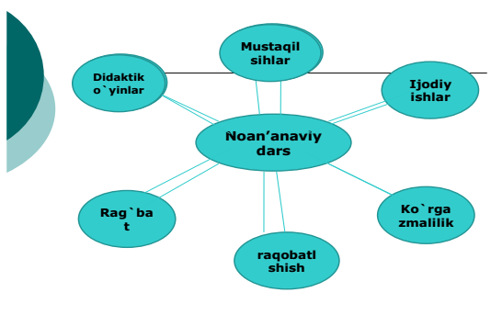

Slide 4
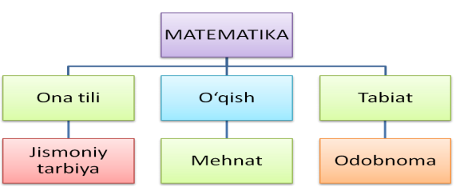

Slide 5
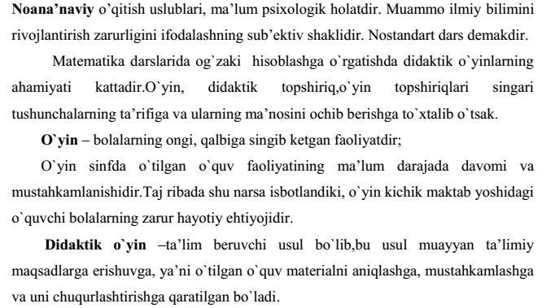

Slide 6
“ZINAMA-ZINA”METODI
 |  |  |  |  | 2*4 |  | 3*3
 |  |  |  | 6:2 |  |  |  | 8:4
 |  |  | 20*4 |  |  |  |  |  | 30*3
 |  | 60:2 |  |  |  |  |  |  |  | 80:4

Slide 7
Jadval bo`yicha misollar tuzing va ularni yeching:
Kamayuvchi | 57 | 40*2 | 30*3 | 50*2 | 80:4
Ayriluvchi | 50:5 | 38 | 20*4 | 90:3 | 60:3

Slide 8
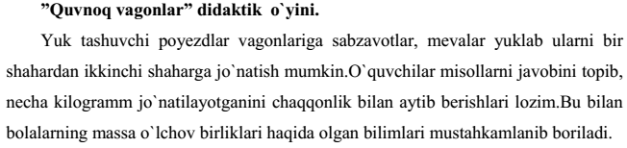

Slide 9


